Slide 1
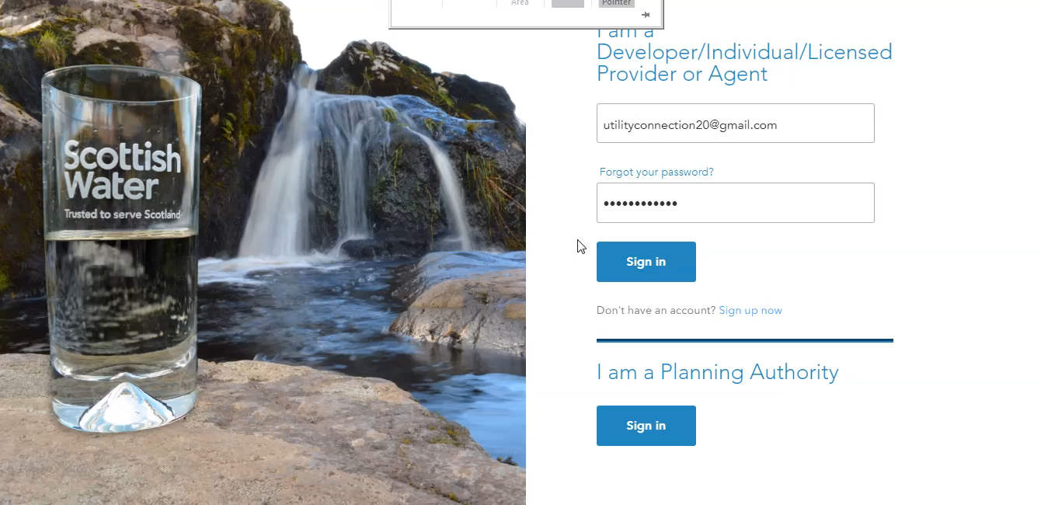
Logging in and inviting a colleague

Slide 2
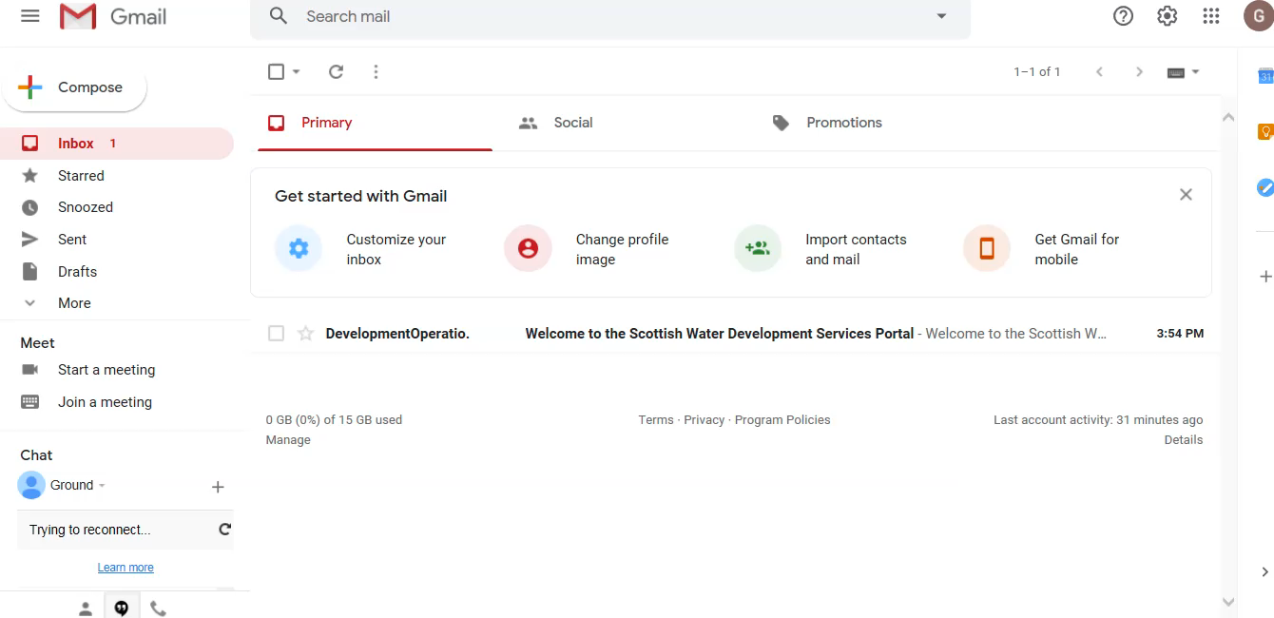
Receiving an invite from your admin & registering

Slide 3
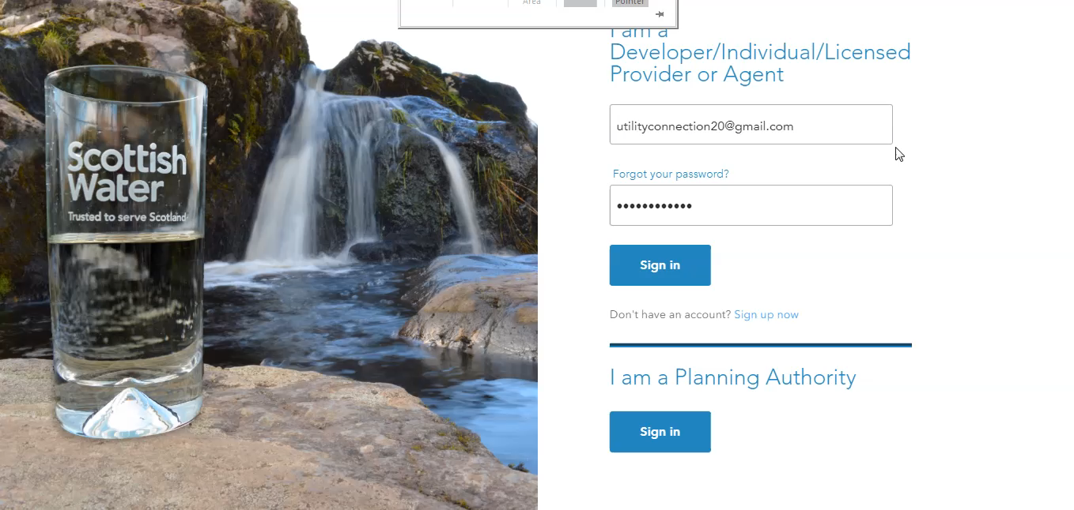
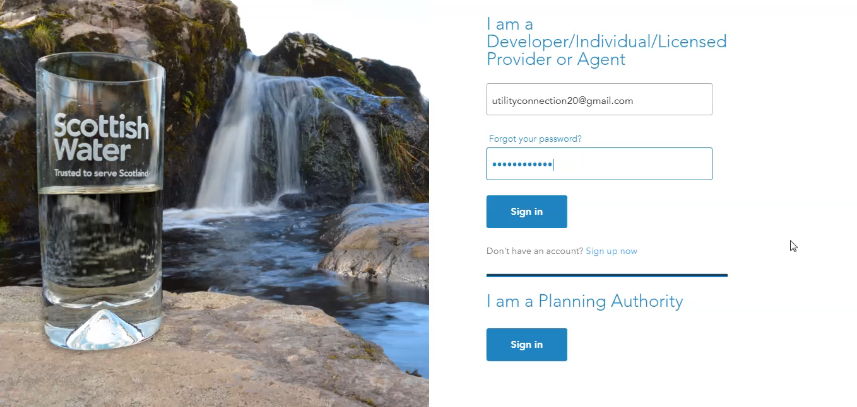
Transfer from case manager to case manager

Slide 4
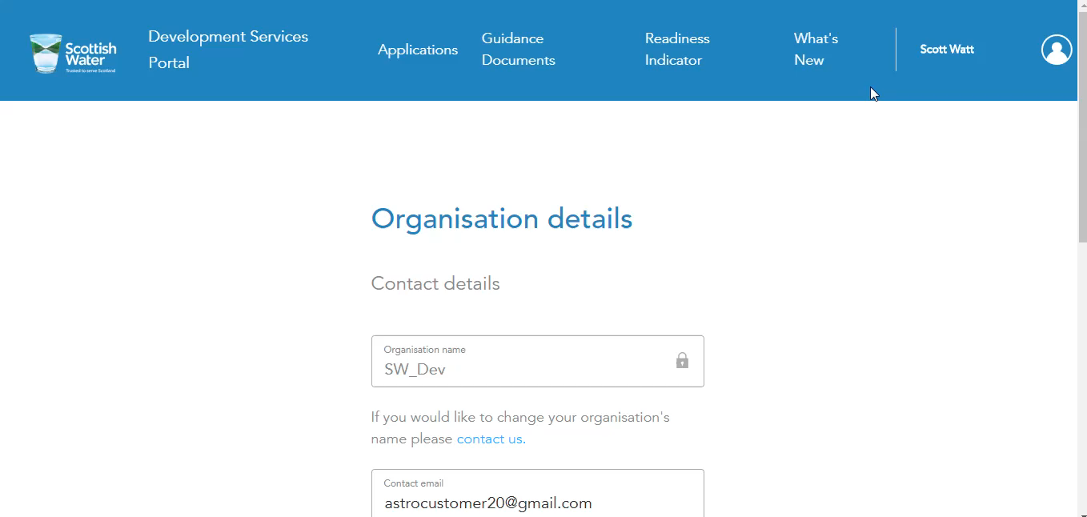
Change Case Manager and End Customer

Slide 5
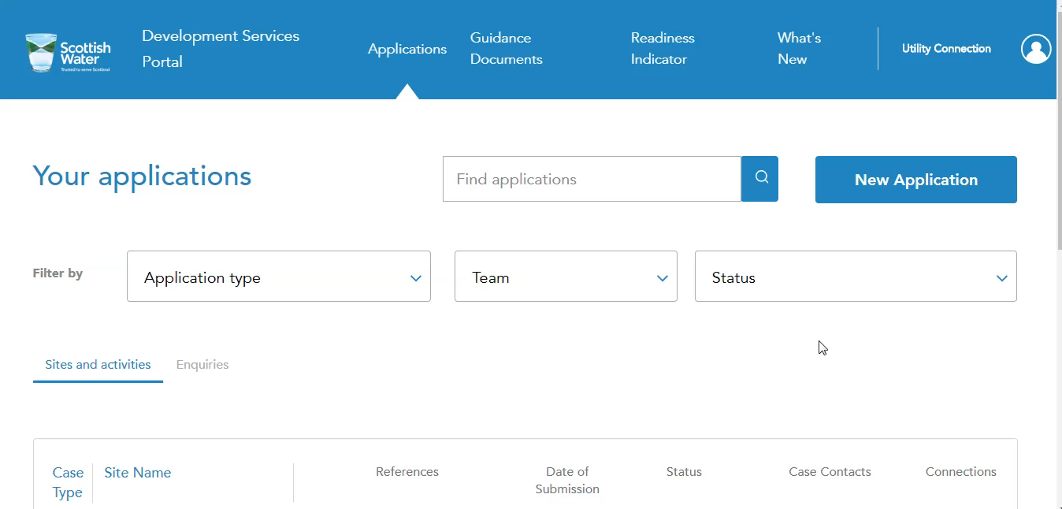
Difference between Admin and Member – More Detail

Slide 6
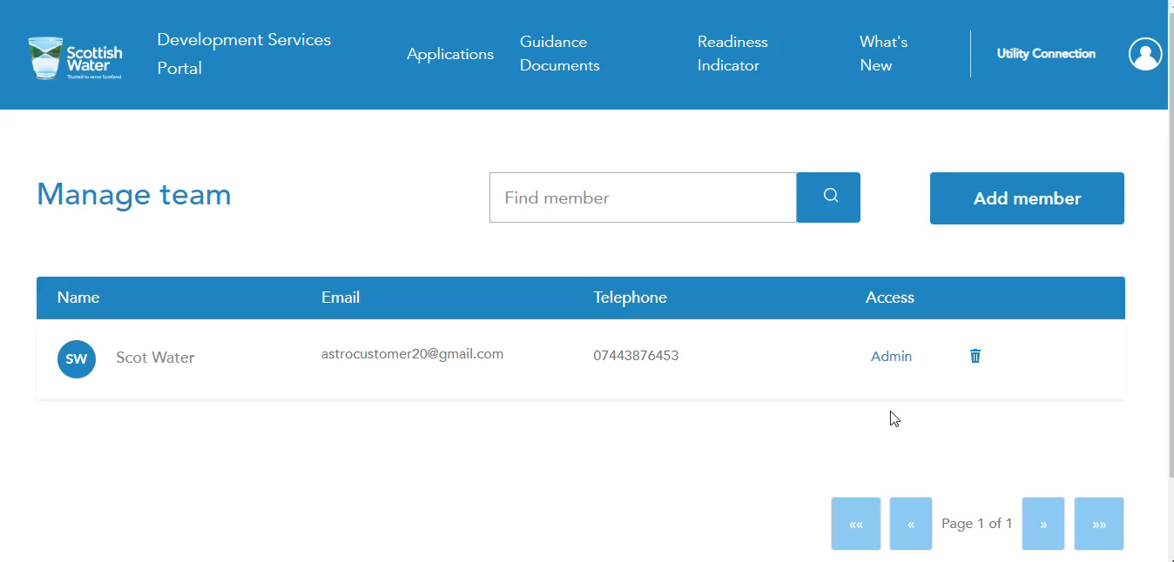
Case Manager and End Customer – more detail

